Slide 1

Bug Tracker System
Course: Software Configuration Management (SFE 4015)
Institution: USIU-A
Presented By:
Esther Waikwa
Christopher Njihia
Peter Njoroge

Slide 2
Project Overview
Objective: Develop a full-stack bug tracker system for software development teams.
Key Features:
- User authentication (login/registration)
- CRUD operations for bug reports
- Status workflow (Open → In Progress → Resolved)
- Priority classification (High/Medium/Low)
- Comment system for collaboration
Technologies Used:
- Frontend: React.js + Vite
- Backend: Node.js + Express
- Database: SQLite

Slide 3

Key Features Overview
Bug Reporting & Tracking: Users can submit, view, and update bug reports.
Status Workflow: Track bug status from "Open" to "Resolved."
Priority Classification: Classify bugs by priority: High, Medium, Low.
User Collaboration: Comment system for team collaboration.

Slide 4
Version Control with GitFlow
Branching Strategy:
- Used GitFlow for version control.
- Key branches: `main`, `develop`, `feature/`, `release/`, `hotfix/`.
- Version tagging: `v1.0-alpha`, `v1.0-beta`, `v1.0-final`.

Slide 5
Change Management Process
Change Requests (CRs):
- Managed and tracked CRs using GitHub Issues.
- Sample CRs: Adding login functionality, bug fixes, feature additions.
Approval Process:
- CRs were reviewed, approved, and tracked.

Slide 6
Continuous Integration & Automation
CI/CD Pipeline:
- Set up GitHub Actions for automated builds and tests.
- Linting and testing triggered on push/pull request events.
- Ensured code quality with automated checks.

Slide 7
Release Management
Release Process:
- Defined versioning and tagging strategies.
- Prepared and deployed `v1.0-beta` and `v1.0-final` releases.
Release Notes: Documented features and known issues in the release notes.

Slide 8

Audit and Reporting
Audit Results:
- Verified CRs and version control practices.
- Ensured that all changes were tracked and documented.
CI Build Verification: Reviewed successful builds and commit history.

Slide 9

Challenges Faced
Deployment Issues: Faced some initial deployment bugs (fixed with proper configuration).
Testing Limitations: Had limitations with SQLite in scaling for large data sets.
UI Responsiveness: Solved UI issues for mobile responsiveness.

Slide 10
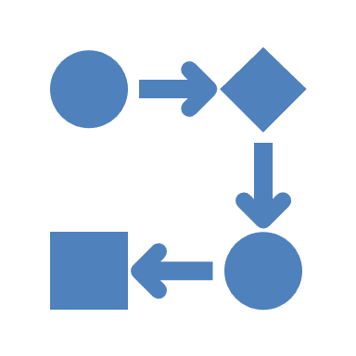
Lessons Learned
GitFlow Discipline: Importance of following a clear branching strategy.
CI Automation: Streamlined the development process with automated builds.
Documentation: Keeping proper documentation at each milestone is key.
Collaboration: Working with team members and using GitHub Issues for tracking changes proved invaluable.

Slide 11
[ LIVE DEMO ]

Slide 12
Conclusion
Final Thoughts:
- Successful implementation of a Bug Tracker System.
- Demonstrated the application of SCM principles in a real-world project.
Repository Link: [https://github.com/crnjihia/bug-tracker]
Questions?

